Slide 1
General course
2022-2023
Programming 2
Serialization & Deserialization
Serhat Erdogan

Slide 2
Last week
Repetition of what we saw last week

Slide 3
Goals of this lesson
Student can define Serialization and use this concept in Python.
Student can define Deserialization and use this concept in Python.
Student can explain when Serialization & Deserialization is usefull to use.
Student can sum up the differences between Json and Pickel library.
Student can use Pickle library to Serialization & Deserialization python different objects.

Slide 4
Content table
What is Serialization & Deserialization?
Why should we use Serialization?
Json library
Pickle library

Slide 5
Content table
What is Serialization & Desialization?
Why should we use Serialization?
Json library
Pickle library

Slide 6
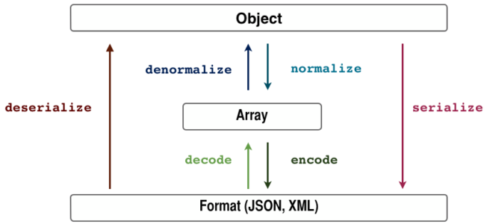
What is Serialization?
“Serialization refers to the process of converting a data object into a format (JSON, XML, HDF5, …) that allows us to store or transmit the data and then recreate the object when needed using the process of deserialization.”

Slide 7

Why or when is serialization interesting to use?

Slide 8

Why use serialization?
Storing and transmitting and integer
Sender
Receiver
Save the integer in a file
Send the file to the receiver
Internet
Receive data (integer)
Use data
Python Program
Java Program
How can we send an python object (with much more complex data) to the receiver?

Slide 9
Why use serialization?
Serializing a python object into a certain format and transmitting it to the receiver
Sender
Receiver
Serialize python object into a format (json)
Transmit data
Receive data
Deserialize data
Use data
Python Program
Internet
Java Program

Slide 10
Example Serialization
Doesn’t necesarily need to be deserialized into a Python Object. This can also be deserialized into a Java Object.
Python Object (dictionary)
Serialize
Deserialize
Python Object
(dictionary)
Json string
data = {
"id": "877",
"name": "Mayur",
"department": "Comp"
}
{"id": "877", "name": "Mayur", "department": "Comp"}
data = {
"id": "877",
"name": "Mayur",
"department": "Comp"
}

Slide 11
Content table
What is Serialization & Deserialization?
Why should we use Serialization?
Json library
Pickle library

Slide 12
Example code Serialization & Deserialization
# importing the module
import json
data = {
"id": "877",
"name": "Mayur",
"department": "Comp"
}
# Serializing json
json_object = json.dumps(data)
print(json_object)
print("Serialization Completed.")
# importing the module
import json
# JSON string
students = "{"id":"9607", "name": "Sunny", "department":"Computer"}"
# convert string to Python dict (deserializing)
student_dict = json.loads(students)
print(student_dict)
print(student_dict["name"])
print("Deserialization Completed.")
Dictionary object
Json
file
Json
format
Dictionary object
Output:
{"id": "877", "name": "Mayur", "department": "Comp"}
Serialization Completed.
Output:
{"id": "9607", "name": "Sunny", "department":"Computer"}
Sunny
Deserialization Completed.
Notes:
using the JSON module we can serialize and deserialize several standard Python types like bool, dict, int, float, list, string, tuple, none etc. The JSON module and XML are a good choice if we want to interoperability among different languages.

Slide 13
Example code dumps & loads
# importing the module
import json
data = {
"id": "877",
"name": "Mayur",
"department": "Comp"
}
# Serializing json
json_object = json.dumps(data)
print(json_object)
print("Serialization Completed.")
# importing the module
import json
# JSON string
students = "{"id":"9607", "name": "Sunny", "department":"Computer"}"
# convert string to Python dict
student_dict = json.loads(students)
print(student_dict)
print(student_dict["name"])
print("Deserialization Completed.")
Dictionary object
json.dumps() function converts a Python object into a json string.
Json
file
Json
format
Dictionary object
Output:
{"id": "877", "name": "Mayur", "department": "Comp"}
Serialization Completed.
Output:
{"id": "9607", "name": "Sunny", "department":"Computer"}
Sunny
Deserialization Completed.
Notes:
using the JSON module we can serialize and deserialize several standard Python types like bool, dict, int, float, list, string, tuple, none etc. The JSON module and XML are a good choice if we want to interoperability among different languages.

Slide 14
Example code dumps & loads
# importing the module
import json
data = {
"id": "877",
"name": "Mayur",
"department": "Comp"
}
# Serializing json
json_object = json.dumps(data)
print(json_object)
print("Serialization Completed.")
# importing the module
import json
# JSON string
students = "{"id":"9607", "name": "Sunny", "department":"Computer"}"
# convert string to Python dict
student_dict = json.loads(students)
print(student_dict)
print(student_dict["name"])
print("Deserialization Completed.")
json.loads() method can be used to parse a valid JSON string and convert it into a Python Dictionary.
Dictionary object
Json
file
Json
format
Dictionary object
Output:
{"id": "877", "name": "Mayur", "department": "Comp"}
Serialization Completed.
Output:
{"id": "9607", "name": "Sunny", "department":"Computer"}
Sunny
Deserialization Completed.
Notes:
using the JSON module we can serialize and deserialize several standard Python types like bool, dict, int, float, list, string, tuple, none etc. The JSON module and XML are a good choice if we want to interoperability among different languages.

Slide 15
Content table
What is Serialization & Deserialization?
Why should we use Serialization?
Json library
Pickle library

Slide 16
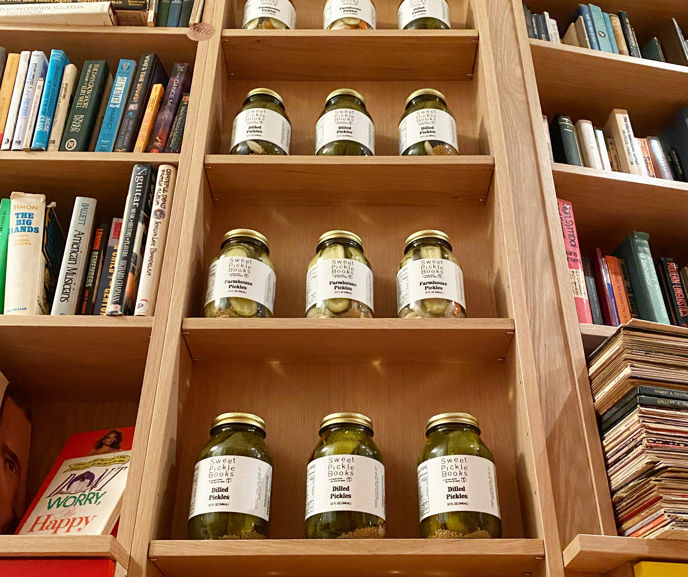
Pickle library
JSON can only store basic structures such as a list and dictionary
More powerful serialization formats exist. In the following, we will explore serialization library in Python named pickle.
Notes:
In Python, there are many different formats for serialization available. One common example of hash maps (Python dictionaries) that works across many languages is the JSON file format which is human-readable and allows us to store the dictionary and recreate it with the same structure. But JSON can only store basic structures such as a list and dictionary, and it can only keep strings and numbers. We cannot ask JSON to remember the data type (e.g., numpy float32 vs. float64). It also cannot distinguish between Python tuples and lists.
More powerful serialization formats exist. In the following, we will explore two common serialization libraries in Python, namely pickle and h5py.

Slide 17



Pickle vs JSON
Pickle | JSON
Pickle lets the user store data in binary format. | JSON lets the user store data in human readable textformat.
Not only the data fields but with pickle module, even classes and methods can be serialized and deserialized. | Json is limited to certain python objects and it cannot serialize every python object.
Pickling is specific to Python and it doesn’t guarantee cross-language compatibility. | Json is supported by almost all the programming languages. Json is language independent.
Notes:
https://www.educba.com/python-pickle-vs-json/

Slide 18
Example code Pickle library
import pickle
# A test object
data = {
"id": "877",
"name": "Mayur",
"department": "Comp"
}
# Serialization
with open("test.pickle", "wb") as outfile:
pickle.dump(data, outfile)
print("Written object", data)
# Deserialization
with open("test.pickle", "rb") as infile:
data_reconstructed = pickle.load(infile)
print("Reconstructed object", data_reconstructed)
if data == data_reconstructed:
print("Reconstruction success")
Output:
Written object {'id': '877', 'name': 'Mayur', 'department': 'Comp'}
Reconstructed object {'id': '877', 'name': 'Mayur', 'department': 'Comp'}
Reconstruction success

Slide 19
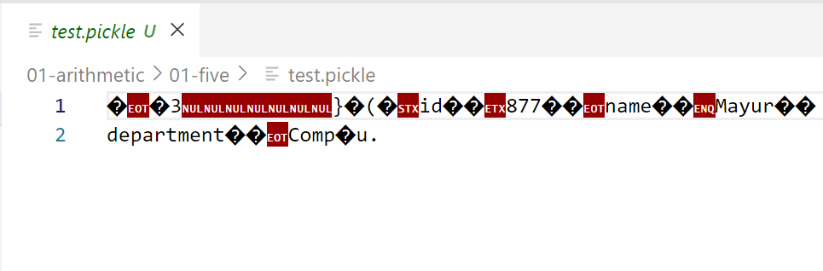
Pickle library binary
import pickle
# A test object
data = {
"id": "877",
"name": "Mayur",
"department": "Comp"
}
# Serialization
with open("test.pickle", "wb") as outfile:
pickle.dump(data, outfile)
print("Written object", data)
The pickle module implements binary protocols for serializing and de-serializing a Python object structure.
To serialize a Python object such as a dictionary and store the byte stream as a file, we can use pickle’s dump() method.

Slide 20
Example code Pickle library
import pickle
# A test object
data = {
"id": "877",
"name": "Mayur",
"department": "Comp"
}
# Serialization
with open("test.pickle", "wb") as outfile:
pickle.dump(data, outfile)
print("Written object", data)
# Deserialization
with open("test.pickle", "rb") as infile:
data_reconstructed = pickle.load(infile)
print("Reconstructed object", data_reconstructed)
if data == data_reconstructed:
print("Reconstruction success")
To recover the original object, we read the serialized byte stream from the file using pickle’s load() method.
Output:
Written object {'id': '877', 'name': 'Mayur', 'department': 'Comp'}
Reconstructed object {'id': '877', 'name': 'Mayur', 'department': 'Comp'}
Reconstruction success
Notes:
Note: echt voorbeeld wat je kan met pickle en niet json

Slide 21
Summarize Pickle serialization and deserialization
This is how you pickle your file:
And this is how you unpickle your file:
It is also possible to pickle an object to a bytes sequence with the dumps() function:
You can get the object back with the loads() function:
import pickle
with open("data.pkl", "wb") as f:
pickle.dump(data, f)
bytes_sequence = pickle.dumps(data)
with open("data.pkl", "rb") as f:
data = pickle.load(f)
data = pickle.loads(bytes_sequence)

Slide 22
Pickle serialization of a function
import pickle
def my_func(num): print(f'my function will add 1 to the number {num}’) return num + 1
my_func(10)
# Serialization
bytes_sequence = pickle.dumps(my_func)
# Deserialization
my_func_unpickled = pickle.loads(bytes_sequence)
my_func_unpickled(10)
Function we want to serialize
Serialize & deserialize function
Output:
My function will add 1 to the number 10
My function will add 1 to the number 10

Slide 23
Pickle serialization of a class object
import pickle
class Animal:
def __init__(self, name, group):
self.name = name
self.group = group
tiger = Animal(“tiger”, “mammals”)
crocodile = Animal(“crocodile”, “reptiles”)
serialized_data = pickle.dumps([tiger, crocodile])
deserialized_data = pickle.loads(serialized_data)
[print(i.__dict__) for i in deserialized_data]
Output:
{'name': 'tiger', 'group': 'mammals'}
{'name': 'crocodile', 'group': 'reptiles'}

Slide 24
Repetition of this lesson
What is Serialization & deserialization?
How can serialization and deserialization be used?
What are the differences between using standard JSON or Pickle library?
What more can you do with Pickle?
What is is the downside of using Pickle?

